Slide 1

System Configuration TankMaster Winsetup

Slide 2
Lesson Goal
Get knowledge about how to:
Check communication protocol and com port settings
Install and configure 2160 Field communication unit
Install and confiugure 2410 Tank Hub
Install and configure 5900 Radar level gauge
Install and configure 2240 temperature transmitter
Install and configure 5300/5400
Check system units
Install tanks
Labworks

Slide 3
Main Window
Pop up area
Work space
Folders for Tanks,
devices and protocols
“Green ball” – shows that
system is alive
Login info

Slide 4
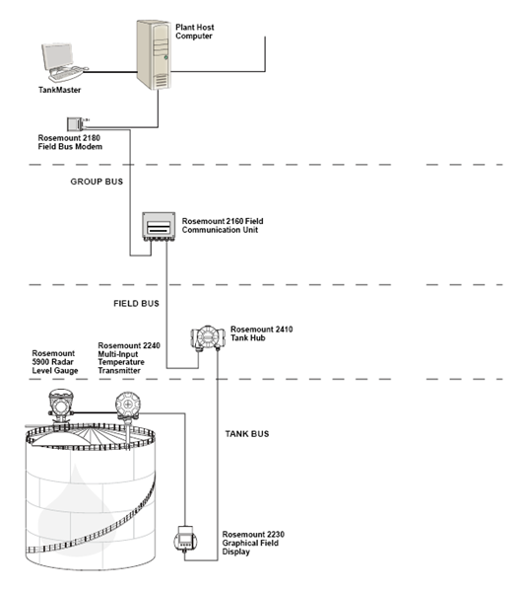
Installation Procedure
Preferences - Configure system units.
Communication protocol setup - Specify communication protocol parameters.
Installation and configuration of 2160 Field Communication Unit
Installation and configuration of 2410 Tank Hub
Configuration of Level device
Configuration of ATD device
Installation and configuration of Tanks
Fine Calibration of level device

Slide 5
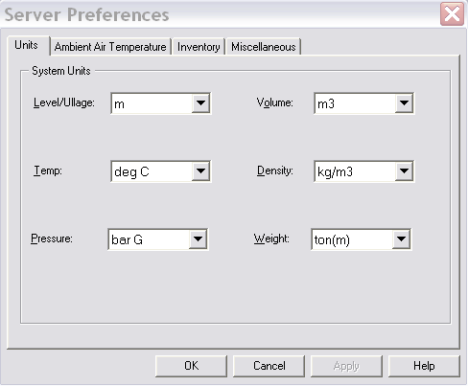
System Units
Specify correct System Units before installing any tanks, it will not be possible to change afterwards without unistalling the tank

Slide 6
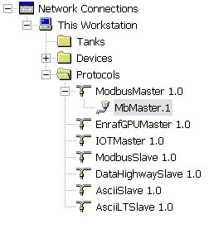
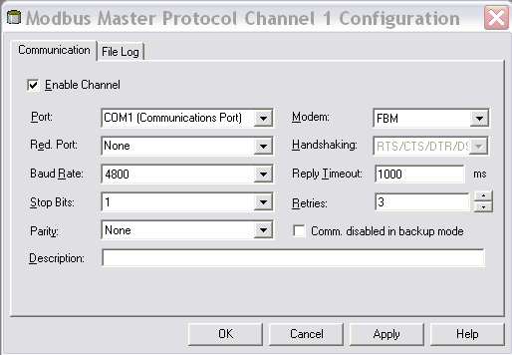
Protocols
Two types of protocols
Master
Collects data from field devices
Slave
Sends data to HOST systems

Slide 7
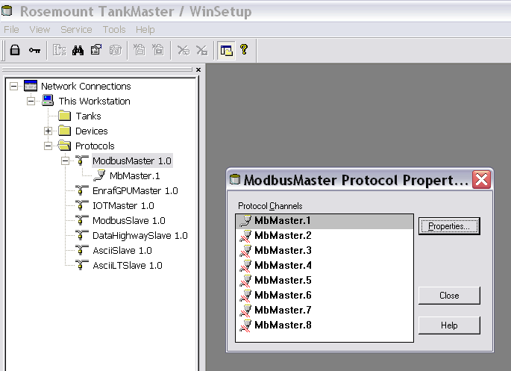
Enable ModbusMaster channel
Protocol Servers available
Up to 8 communication channels/protocol servers
MbMaster used for TRL/2 bus

Slide 8
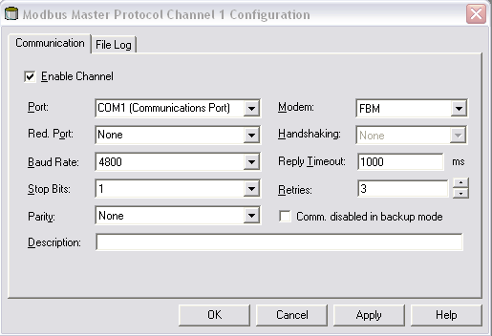
Modbus Master Channel
Port :The COM port that the Rosemount 2180 will be connected to
Baud rate: 4800
Stop bits: 1
Parity: None
Modem: FBM if a Rosemount 2180 is used.
Handshaking:
FBM: RTS/CTS/DTR/DSR
RS485: RTS/CTS
RS232: None
Reply timeout 1000 ms
Retries 3

Slide 9
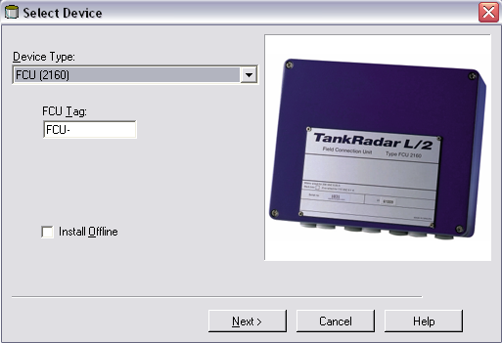
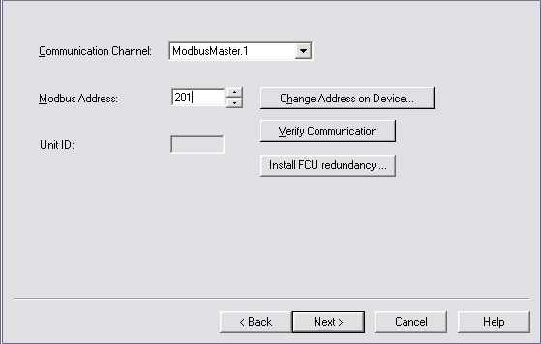
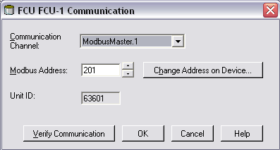
Installing FCU 2160

Slide 10
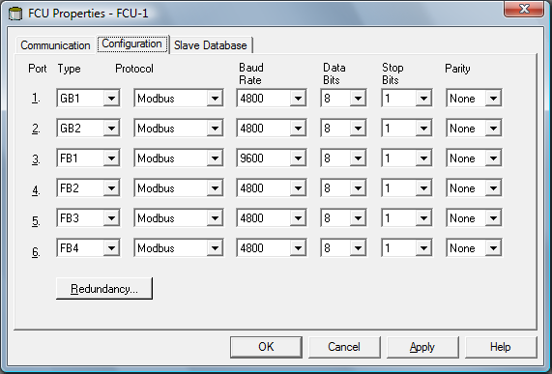
Bus Configuration
Parameter RS485 bus
Baud rate 9600
Databits per character 8
Stop bits 1
Parity No
(default) TRL2 bus
Baud rate 4800
Databits per character 8
Stop bits 1
Parity No

Slide 11
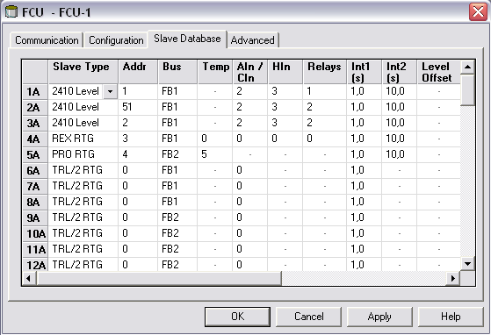
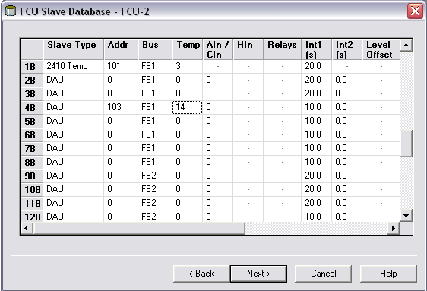
Slave Database Configuration

Slide 12
Slave Database Configuration
Slave type
2410 Level, (pos 1A-32A) or 2410 Temp, (pos 1B-32B)
Address
The Modbus address used for the connected devices. For level gauges it is recommended that address 1 to 99 is used. For ATD devices address 101 to 199 are recommended
FCU field bus
The field bus that the selected device is connected to. In the standard configuration there are four field buses available
Temps
The number of temperature sensors connected to the temperature transmitter (for example a Rosemount 2240)
Analog inputs
Automatically configured
Hin
Automatically configured
Relays
Automatically configured
Interval 1
Automatically configured
Interval 2
Automatically configured
Level Offset
Not used

Slide 13
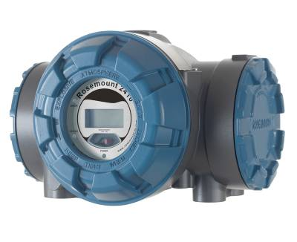
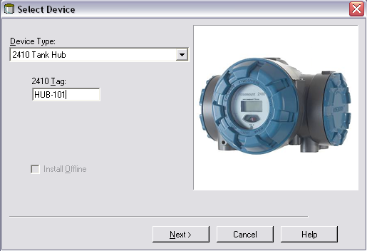
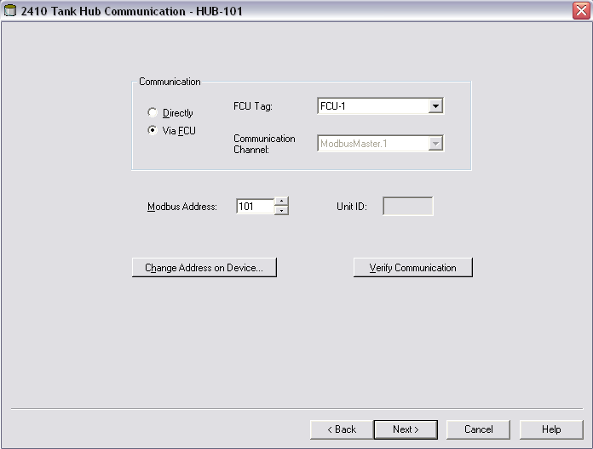
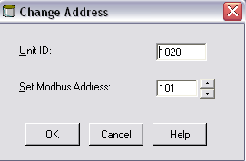
Installing 2410 Tank Hub

Slide 14
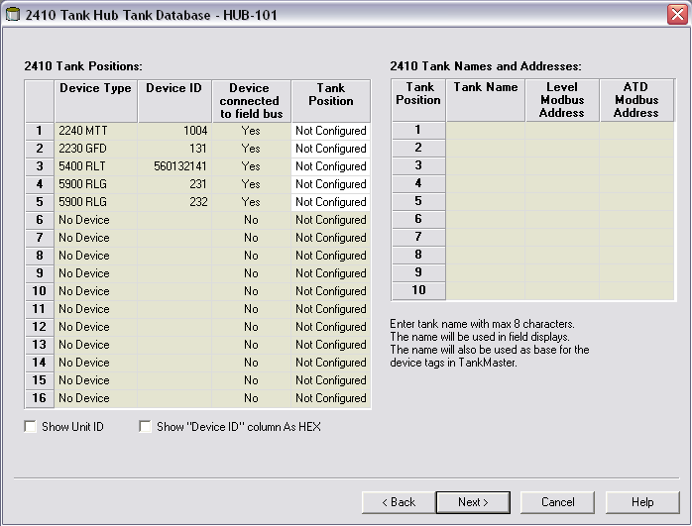
2410 Tank Database
Identify the FF devices with help of device type and device id number.
Associate FF devices to 2410 tank position.
Enter tank name for used tank positions . The tank name will be used in field displays.
Enter modbus addresses for level and ATD device.

Slide 15
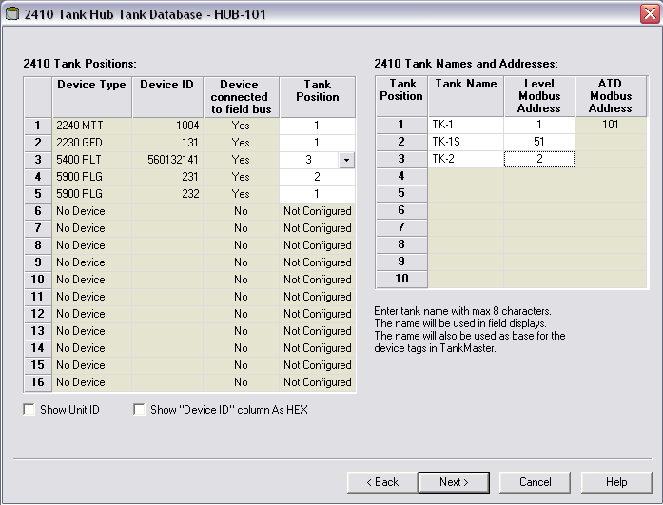
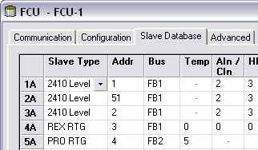
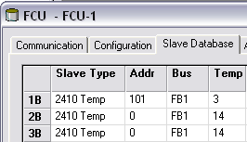
2410 Tank Database Config

Slide 16
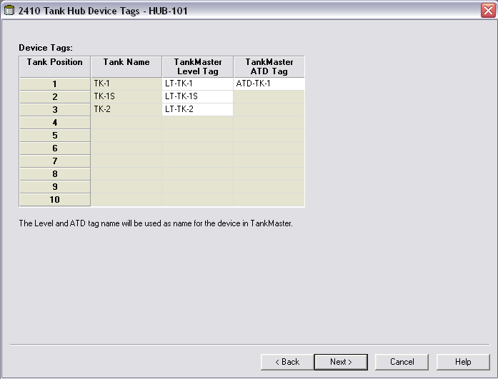
2410 Device Tags

Slide 17
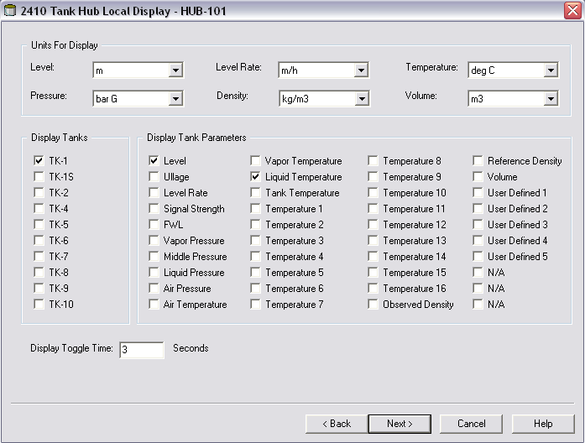
2410 Tank Hub Local Display
Units for the shown values
Tanks and Parameters
Display Toggle time

Slide 18
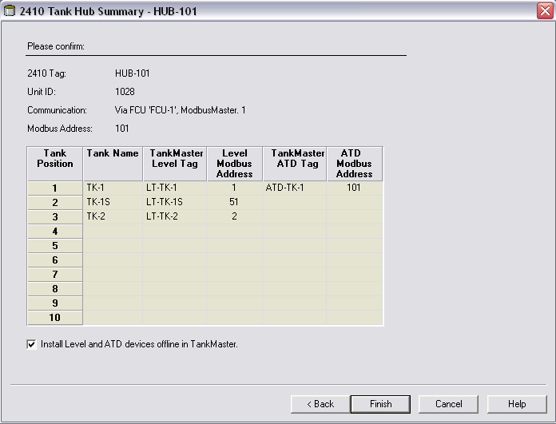
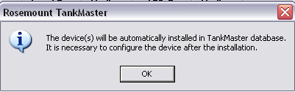
2410 Tank Hub Summary
All Level & ATD devices will be auto installed by default
All Level & ATD devices must be configured to work properly

Slide 19
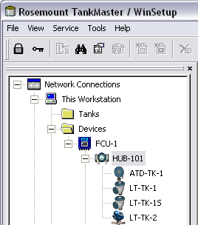
Automatic Installation of Devices

Slide 20
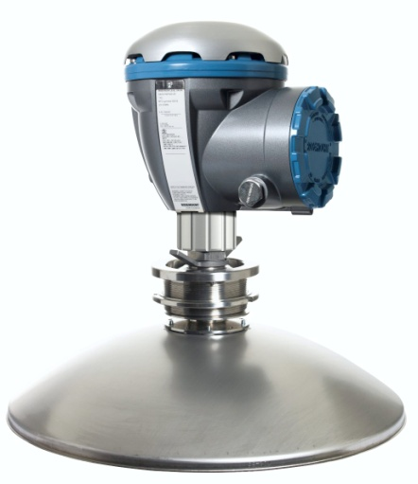
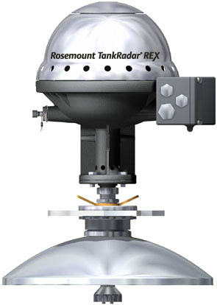
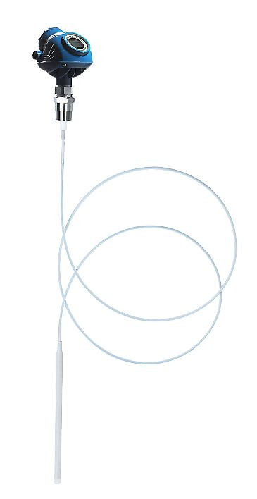
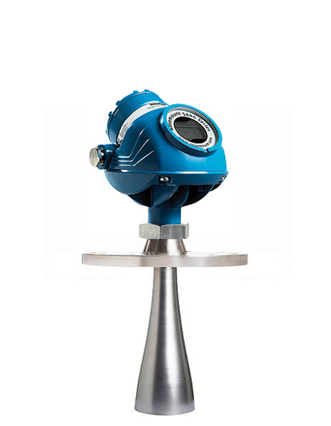
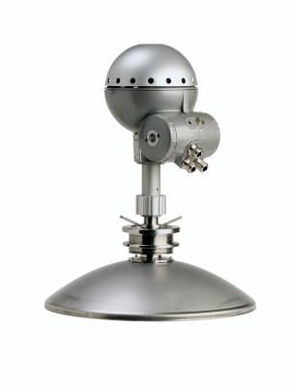
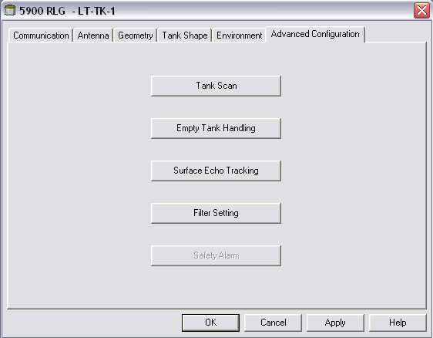
Configuration of Level Devices
Configuration normally done via device ’Properties’
Basic Configuration steps:
Communication; if e.g. the address shall be changed
Antenna related parameters
Tank geometry parameters
Additionall Configuration steps (optional):
Tank Shape
Environment
Advance Configuration steps (5900S):
Tank Scan
Empty Tank Handling
Surface Echo Tracking
Filter Setting
Safety Alarm, SIL Configuration (enabled only if the 5900S SIL option is enabled)

Slide 21
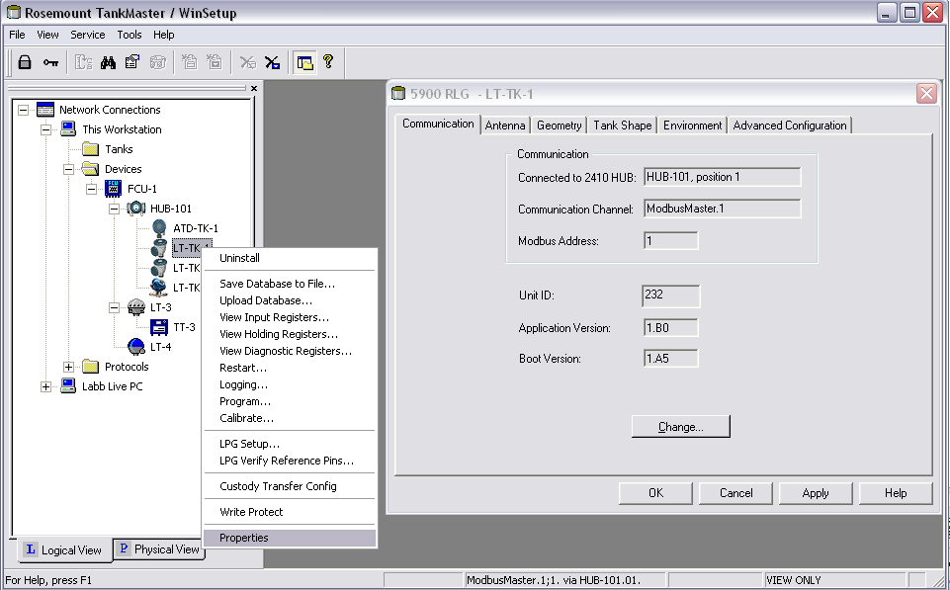
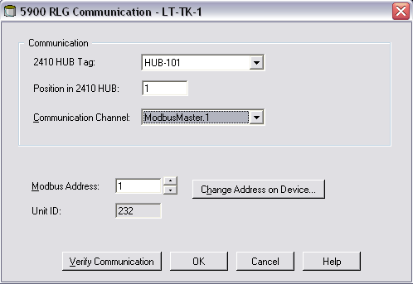
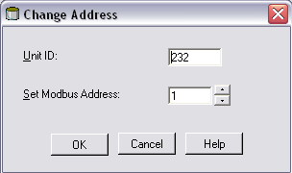
Configuring Rosemount 5900S

Slide 22
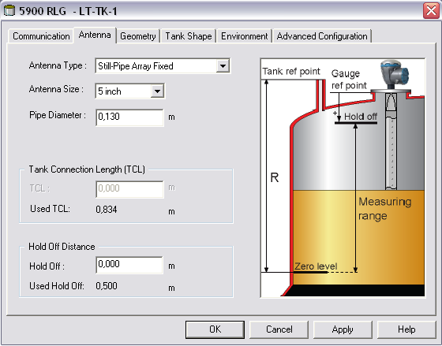
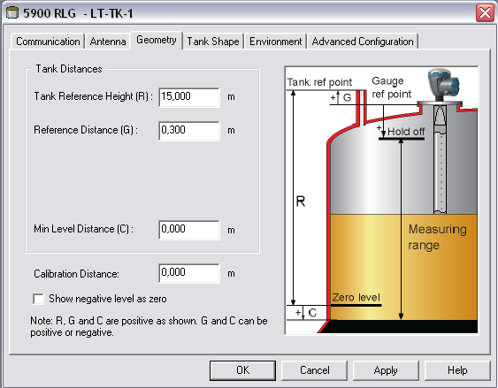
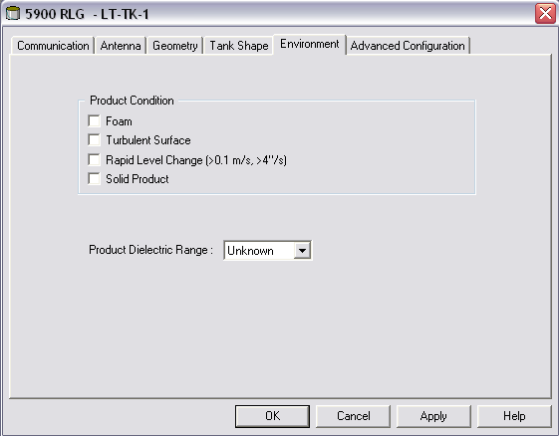
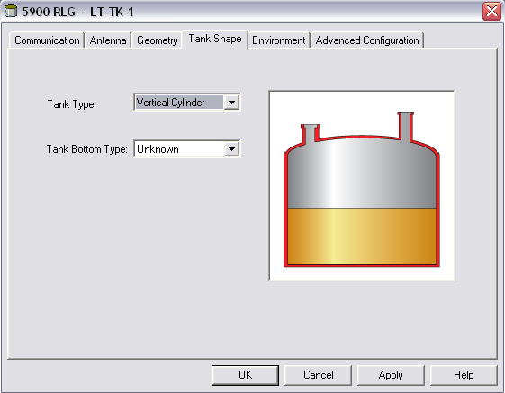
Configuring Rosemount 5900S

Slide 23
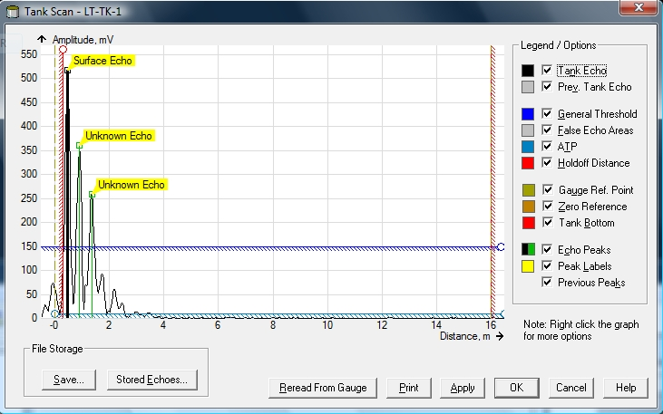
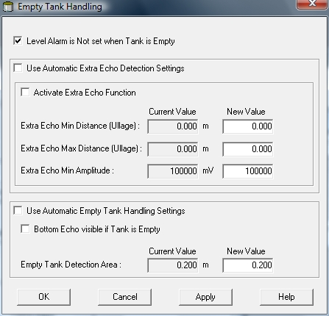
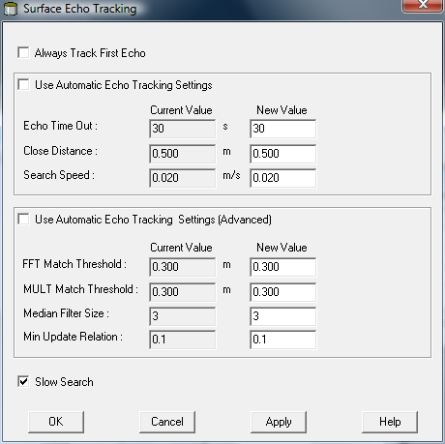
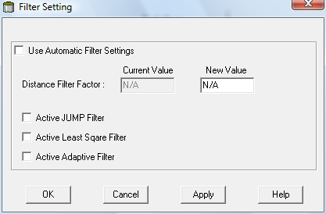
5900S Advanced Configuration

Slide 24
5900S Tank Scan
Scan for false echos
Mark and store to avoid the level measurement to lock on wrong echo

Slide 25
5900S Empty Tank Handling
When surface echo is close to the tank bottom
Track weak product echoes
Handle lost echoes

Slide 26
5900S Surface Echo Tracking
Control how to search for lost surface echoes

Slide 27
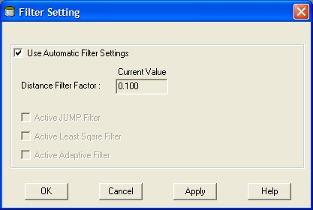
5900S Filter Setting
Activate special filters in 5900S

Slide 28
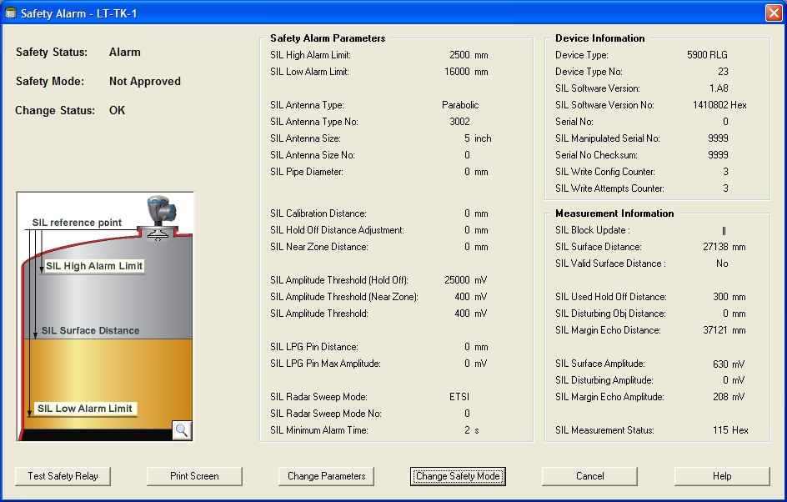
5900S Safety Alarm (SIL)
Set up SIL configuration in 5900S
Main window show the current safety alarm configuration and status

Slide 29
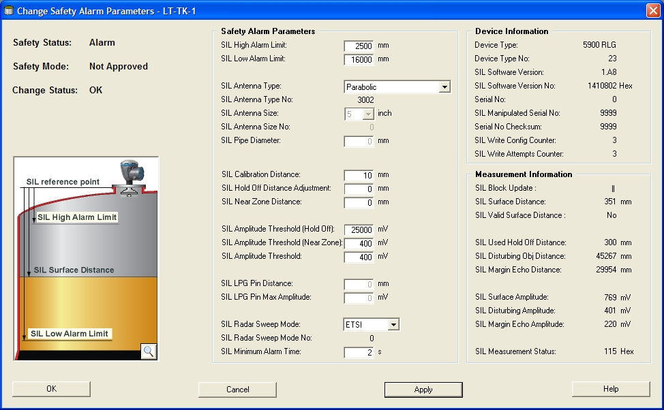
5900S Safety Alarm (SIL)
Change Safety Alarm Parameters - To change the current SIL configuration

Slide 30
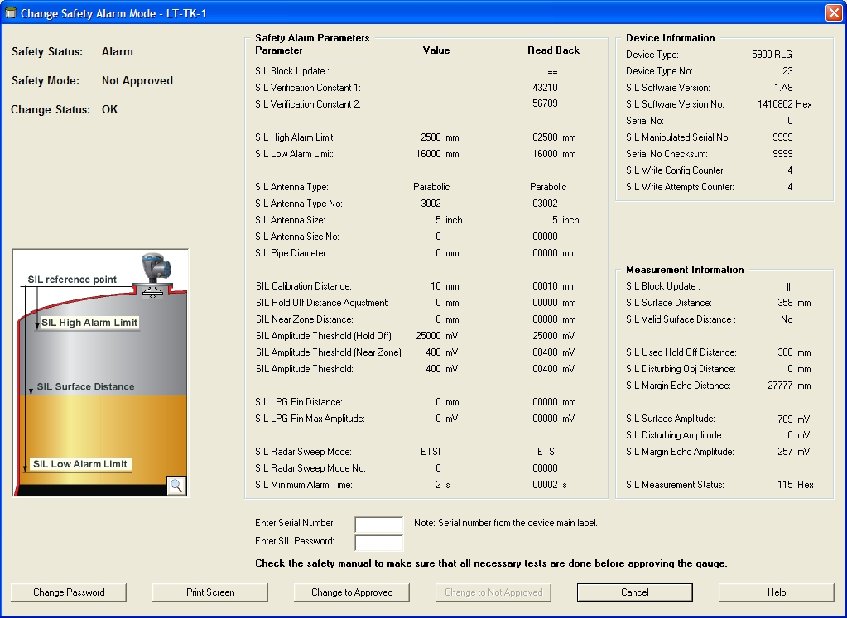
5900S Safety Alarm (SIL)
Change Safety Mode – Approve the SIL Configuration

Slide 31
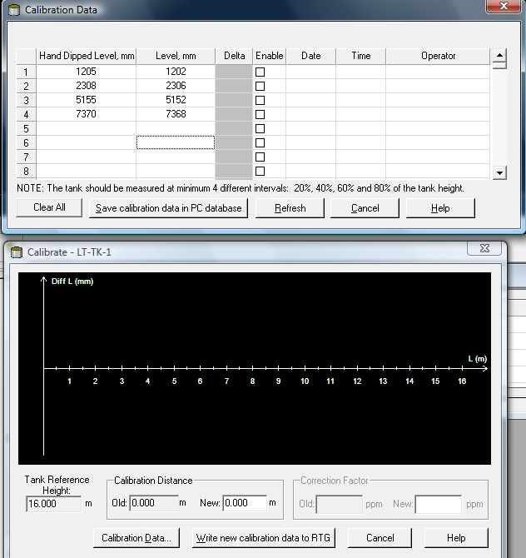
5900S Calibration
Set calibration distance in order to match measured level and actual product level
Adjustmend should be performed once at the final commissioning
May need to be repeated if tank conditions changes
Special function in Winsetup

Slide 32
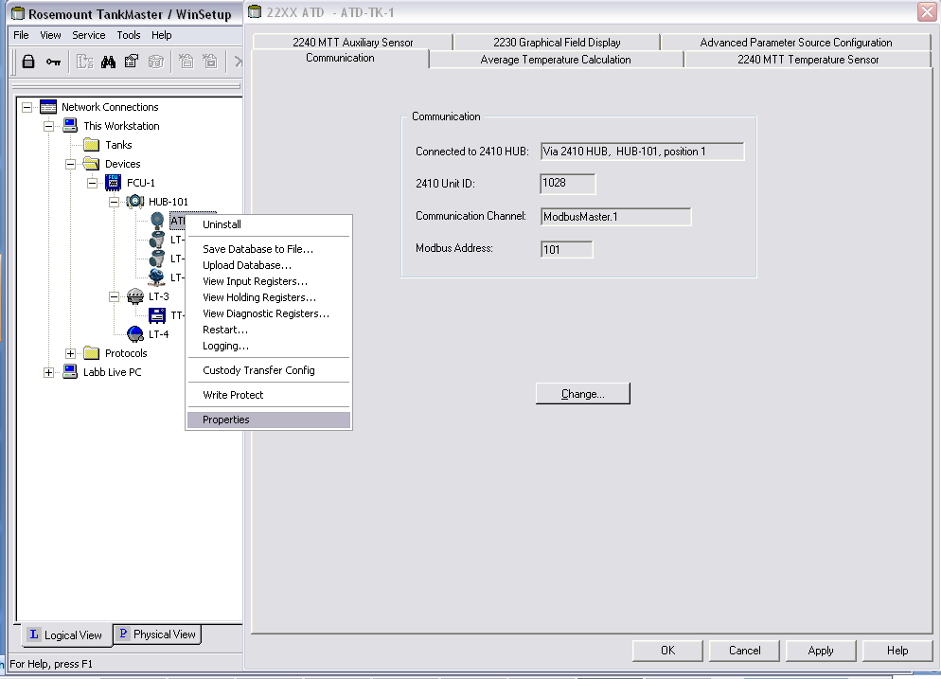
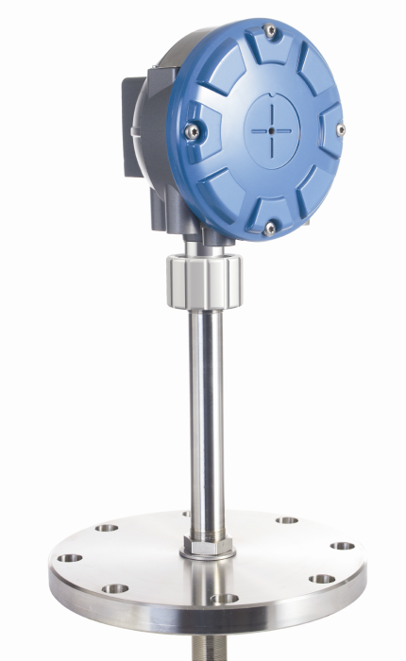
Configuring Auxiliary Tank Device

Slide 33
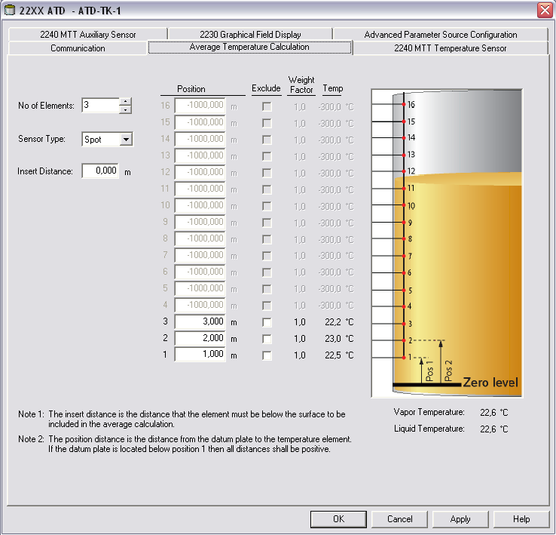




Configuring Auxiliary Tank Device
3051 PT / 34 / (No5)

Slide 34


Configuring Rosemount 5400

Slide 35





Configuring Rosemount 5400

Slide 36


Configuring Rosemount 5300

Slide 37




Configuring Rosemount 5300

Slide 38


Installing & Configuring Rex

Slide 39




Installing & Configuring Rex

Slide 40







Installing & Configuring Rex

Slide 41

Installing & Configuring Pro

Slide 42








Installing & Configuring Pro

Slide 43


System Units - Reminder
Specify correct System Units before installing any tanks, it will not be possible to change afterwards without unistalling the tank

Slide 44


Installing Tanks

Slide 45

Installing Tanks
Select a devices to be connected to the tank

Slide 46

Installing Tanks
Configure source for tank input parameters (default often ok)
Notes:
The Tank Configuration window lets you enable tank measurement variables
such as Vapor Temperature, Vapor Pressure, Liquid Pressure, and Free
Water Level (FWL) to be used for calculations of Observed Density and
other inventory parameters.
The Calculate in TankMaster check box may be used for devices without
internal calculation of Level Rate. By selecting this check box the Level Rate
is calculated by the TankMaster program.
Liquid Pressure and Vapor Pressure are not automatically mapped to
measurement instruments. These measurement variables have to be mapped
to an instrument in the 22XX ATD/Parameter Source window in order to be
available in the Tank Configuration window.

Slide 47

Installing Tanks
Possible to set a manual value for tank parameters not connected
Value range sets size of bargraph in WinOpi

Slide 48


Viewing Tanks In Winsetup

Slide 49

Other functions
2410 Tank Hub:
Device Live List
Manual Control of Relay
Simulation
Write Protect
Delta Level calculation
5900S:
Custody Transfer Configuration
Write Protect
ATD:
Custody Transfer Configuration
Write Protect

Slide 50

Other functions in 2410 Tank Hub
The “Device Live List” window will show all devices that the 2410 have detected on the tank bus since it was powered up or restarted.

Slide 51

Other functions in 2410 Tank Hub
In “Manual Control of Relay” window it is possible to change state for a Virtual Relay to test the relay function.

Slide 52

Other functions in 2410 Tank Hub
“Simulation” – set the 2410 in simulation mode
e.g. when communication to DCS system is tested or for demo. The simulated parameter values can be changed via “View Holding Register” window.

Slide 53

Other functions in 2410 Tank Hub
“Write Protect” – write protect the device database.
Required if the device is included in a custody transfer approved system.

Slide 54

Other functions in 2410 Tank Hub
Delta Level calculation
Setup via “View Holding Registers” window
The “Delta Level” parameter can be alarm handled via 2410 Virtual Relay function.
E.g. if 5900S 2-in-1 is used on one tank the diff between the level values can be monitored by the 2410.

Slide 55


Other functions in 5900S
Custody Transfer Configuration
Write Protect

Slide 56


Other functions in ATD
Custody Transfer Configuration
The ATD “Write Protect” window only showa the write protect state.
2230 and 2240S need to be write protected via hardware switch.

Slide 57

Service Functions
Read database from device and store on disk
Restore device database with previously saved database
View read only registers, status, measured/calculated values
Store individually changed values
View gauge status
Restart gauge
Upgrade gauge firmware
Calibrate gauge
View gauge configuration

Slide 58


Load default database for device
“View Holding Registers“ window is used to send the command loading default database.
5900S, write value 65510 to HREG 65510.
2410 Tank Hub, write value 65510 to HREG 65510.

Slide 59


Load default database for device
2410 Tank Hub
After loading default database the units is set to metric units
If imperial units are used it is important to re-configure the value unit configuration in the 2410 Tank Hub.
Open “View Holding Registers“ window.
Read register 6104 “SysCtrl-Trl2_PresCtrl” and change to “Imperial_And_Fahrenheit”
Read register 6140 “SysCtrl-StdQ-LevelUnit” to 6156 “SysCtrl-StdQ-FlowRateUnit” and change to imperial units (Feet, Feet/h, Fahrenheit, Deg_F, Psi_G, degAPI. Barrels, Barrels/h).

Slide 60
Protocols
Real time log
Possible to filter which communication events that are interesting
File log
Manual start/stop, automatic start/stop. Specify media size, filter etc.
Find device on channel
Will send queries on channel and match replies with the device database
Statistics
Counter for e.g. timeouts and checksum errors

Slide 61

Communication Log
All questions sent from TankMaster should be sent only to FCU
C9 HEX = 201 DEC
If questions are sent directly to field equipment, communication settings for the device should be set to ”via FCU”
If questions are sent directly to field devices it will slow down update rate

Slide 62



Save Communication Log to file

Slide 63


Channel Statistics
Check the quality of the communication between TM PC and the connected devices
View a summray of messages and various error types

